Slide 1
0-1 Knapsack problem
By dynamic rogramming

Slide 2
Knapsack problem
Given some items, pack the knapsack to get
the maximum total value. Each item has some
weight and some value. Total weight that we can
carry is no more than some fixed number W.
So we must consider weights of items as well as
their values.
Item # Weight Value
1 1 8
2 3 6
3 5 5

Slide 3
Knapsack problem
There are two versions of the problem:
“0-1 knapsack problem”
Items are indivisible; you either take an item or not. Some special instances can be solved with dynamic programming
“Fractional knapsack problem”
Items are divisible: you can take any fraction of an item

Slide 4
0-1 Knapsack problem
Given a knapsack with maximum capacity W, and a set S consisting of n items
Each item i has some weight w_{i} and benefit value b_{i} (all w_{i} and W are integer values)
Problem: How to pack the knapsack to achieve maximum total value of packed items?

Slide 5
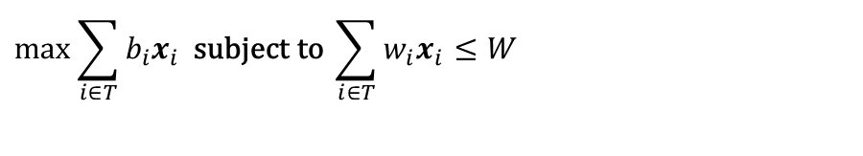
0-1 Knapsack problem
Problem, in other words, is to find
$$\max{\sum_{i∈T}{b_{i}x_{i}}} \text{subject} \text{to} \sum_{i∈T}{w_{i}x_{i}≤W}$$
The problem is called a “0-1” problem, because each item must be entirely accepted or rejected.

Slide 6
0-1 Knapsack problem: brute-force approach
Let’s first solve this problem with a brute force algorithm
Since there are n items, there are 2^{n} possible combinations of items.
We go through all combinations and find the one with maximum value and with total weight less or equal to W
Running time will be O(2^{n})

Slide 7
0-1 Knapsack problem: dynamic programming approach
We can do better with an algorithm based on dynamic programming
We need to carefully identify the subproblems

Slide 8
Defining a Subproblem
Given a knapsack with maximum capacity W, and a set S consisting of n items
Each item i has some weight w_{i} and benefit value b_{i} (all w_{i} and W are integer values)
Problem: How to pack the knapsack to achieve maximum total value of packed items?

Slide 9
Defining a Subproblem
We can do better with an algorithm based on dynamic programming
We need to carefully identify the subproblems
Let’s try this:
If items are labeled 1..n, then a subproblem
would be to find an optimal solution for
S_{k} = {items labeled 1, 2, .. k}

Slide 10
Defining a Subproblem
If items are labeled 1..n, then a subproblem would be to find an optimal solution for S_{k} = {items labeled 1, 2, .. k}
This is a reasonable subproblem definition.
The question is: can we describe the final solution (S_{n} ) in terms of subproblems (S_{k})?
Unfortunately, we can’t do that.

Slide 11
Defining a Subproblem
w₁ =2
b₁ =3
w₂ =4
b₂ =5
w₃ =5
b₃ =8
w₄ =3
b₄ =4
Weight
Benefit
Item
#
w_{i}
b_{i}
?
1
2
3
Max weight: W = 20
For S₄:
Total weight: 14
Maximum benefit: 20
S₄
2
4
5
S₅
3
5
8
4
3
4
5
9
10
w₁ =2
b₁ =3
w₂ =4
b₂ =5
w₃ =5
b₃ =8
w₅ =9
b₅ =10
Solution for S₄ is not part of the solution for S₅!!!
For S₅:
Total weight: 20
Maximum benefit: 26

Slide 12
Defining a Subproblem
As we have seen, the solution for S₄ is not part of the solution for S₅
So our definition of a subproblem is flawed and we need another one!

Slide 13
Defining a Subproblem
Given a knapsack with maximum capacity W, and a set S consisting of n items
Each item i has some weight w_{i} and benefit value b_{i} (all w_{i} and W are integer values)
Problem: How to pack the knapsack to achieve maximum total value of packed items?

Slide 14
Defining a Subproblem
Let’s add another parameter: w, which will represent the maximum weight for each subset of items
The subproblem then will be to compute V[k,w], i.e., to find an optimal solution for S_{k} = {items labeled 1, 2, .. k} in a knapsack of size w

Slide 15
Recursive Formula for subproblems
The subproblem will then be to compute V[k,w], i.e., to find an optimal solution for S_{k} = {items labeled 1, 2, .. k} in a knapsack of size w
Assuming knowing V[i, j], where i=0,1, 2, … k-1, j=0,1,2, …w, how to derive V[k,w]?

Slide 16
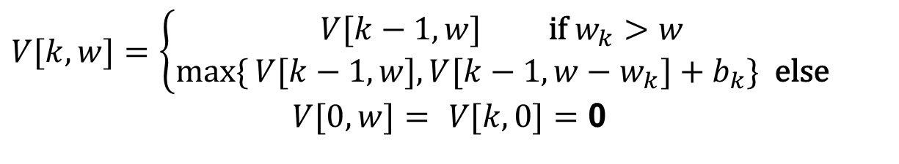
Recursive Formula for subproblems (continued)
Recursive formula for subproblems:
$$V[k,w]=\left\{\begin{matrix}V[k−1,w] \text{if} w_{k}>w \\ \max{\{}V[k−1,w],V[k−1,w−w_{k}]+b_{k}\} \text{else}\end{matrix}\right.$$
$$V[0,w]= V[k,0]=\text{0}$$
It means, that the best subset of S_{k} that has total weight w is:
1) the best subset of S_{k-1} that has total weight ≤ w, or
2) the best subset of S_{k-1} that has total weight ≤ w-w_{k} plus the item k

Slide 17
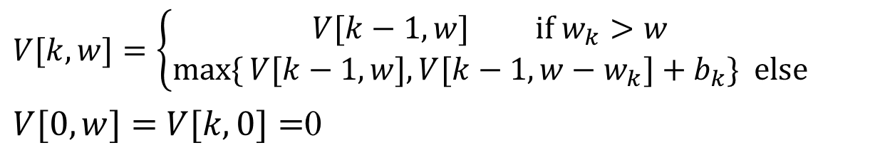
Recursive Formula
$$V[k,w]=\left\{\begin{matrix}V[k−1,w] \text{if} w_{k}>w \\ \max{\{}V[k−1,w],V[k−1,w−w_{k}]+b_{k}\} \text{else}\end{matrix}\right.$$
$V[0,w]=$ $V[k,0]=$0
The best subset of S_{k} that has the total weight ≤ w, either contains item k or not.
First case: w_{k}>w. Item k can’t be part of the solution, since if it was, the total weight would be > w, which is unacceptable.
Second case: w_{k} ≤ w. Then the item k can be in the solution, and we choose the case with greater value.

Slide 18
0-1 Knapsack Algorithm
for w = 0 to W
V[0,w] = 0
for i = 1 to n
V[i,0] = 0
for i = 1 to n
for w = 0 to W
if w_{i} <= w // item i can be part of the solution
if b_{i} + V[i-1,w-w_{i}] > V[i-1,w]
V[i,w] = b_{i} + V[i-1,w- w_{i}]
else
V[i,w] = V[i-1,w]
else V[i,w] = V[i-1,w] // w_{i} > w

Slide 19
Running time
for w = 0 to W
V[0,w] = 0
for i = 1 to n O(n)
V[i,0] = 0
for i = 1 to n
for w = 0 to W
< the rest of the code >
O(W)
Repeat n times
O(W)
What is the running time of this algorithm?
O(n*W)
Remember that the brute-force algorithm
takes O(2^{n})

Slide 20
Example
Let’s run our algorithm on the
following data:
n = 4 (# of elements)
W = 5 (max weight)
Elements (weight, benefit):
(2,3), (3,4), (4,5), (5,6)

Slide 21
Example (2)
i\W
0
1
2
3
4
5
0
0
0
0
0
0
0
1
2
3
4
for w = 0 to W
V[0,w] = 0

Slide 22
Example (3)
i\W
0
1
2
3
4
5
0
0
0
0
0
0
0
1
0
2
0
3
0
4
0
for i = 1 to n
V[i,0] = 0

Slide 23
Example (4)
Items:
1: (2,3)
2: (3,4)
3: (4,5)
4: (5,6)
i\W
0
1
2
3
4
5
i=1
b_{i}=3
w_{i}=2
w=1
w-w_{i} =-1
0
0
0
0
0
0
0
1
0
0
2
0
3
0
4
0
if w_{i} <= w // item i can be part of the solution
if b_{i} + V[i-1,w-w_{i}] > V[i-1,w]
V[i,w] = b_{i} + V[i-1,w- w_{i}]
else
V[i,w] = V[i-1,w]
else V[i,w] = V[i-1,w] // w_{i} > w

Slide 24
Example (5)
Items:
1: (2,3)
2: (3,4)
3: (4,5)
4: (5,6)
i\W
0
1
2
3
4
5
i=1
b_{i}=3
w_{i}=2
w=2
w-w_{i} =0
0
0
0
0
0
0
0
1
0
0
3
2
0
3
0
4
0
if w_{i} <= w // item i can be part of the solution
if b_{i} + V[i-1,w-w_{i}] > V[i-1,w]
V[i,w] = b_{i} + V[i-1,w- w_{i}]
else
V[i,w] = V[i-1,w]
else V[i,w] = V[i-1,w] // w_{i} > w

Slide 25
Example (6)
Items:
1: (2,3)
2: (3,4)
3: (4,5)
4: (5,6)
i\W
0
1
2
3
4
5
i=1
b_{i}=3
w_{i}=2
w=3
w-w_{i} =1
0
0
0
0
0
0
0
1
0
0
3
3
2
0
3
0
4
0
if w_{i} <= w // item i can be part of the solution
if b_{i} + V[i-1,w-w_{i}] > V[i-1,w]
V[i,w] = b_{i} + V[i-1,w- w_{i}]
else
V[i,w] = V[i-1,w]
else V[i,w] = V[i-1,w] // w_{i} > w

Slide 26
Example (7)
Items:
1: (2,3)
2: (3,4)
3: (4,5)
4: (5,6)
i\W
0
1
2
3
4
5
i=1
b_{i}=3
w_{i}=2
w=4
w-w_{i} =2
0
0
0
0
0
0
0
1
0
0
3
3
3
2
0
3
0
4
0
if w_{i} <= w // item i can be part of the solution
if b_{i} + V[i-1,w-w_{i}] > V[i-1,w]
V[i,w] = b_{i} + V[i-1,w- w_{i}]
else
V[i,w] = V[i-1,w]
else V[i,w] = V[i-1,w] // w_{i} > w

Slide 27
Example (8)
Items:
1: (2,3)
2: (3,4)
3: (4,5)
4: (5,6)
i\W
0
1
2
3
4
5
i=1
b_{i}=3
w_{i}=2
w=5
w-w_{i} =3
0
0
0
0
0
0
0
1
0
0
3
3
3
3
2
0
3
0
4
0
if w_{i} <= w // item i can be part of the solution
if b_{i} + V[i-1,w-w_{i}] > V[i-1,w]
V[i,w] = b_{i} + V[i-1,w- w_{i}]
else
V[i,w] = V[i-1,w]
else V[i,w] = V[i-1,w] // w_{i} > w

Slide 28
Example (9)
Items:
1: (2,3)
2: (3,4)
3: (4,5)
4: (5,6)
i\W
0
1
2
3
4
5
i=2
b_{i}=4
w_{i}=3
w=1
w-w_{i} =-2
0
0
0
0
0
0
0
1
0
0
3
3
3
3
2
0
0
3
0
4
0
if w_{i} <= w // item i can be part of the solution
if b_{i} + V[i-1,w-w_{i}] > V[i-1,w]
V[i,w] = b_{i} + V[i-1,w- w_{i}]
else
V[i,w] = V[i-1,w]
else V[i,w] = V[i-1,w] // w_{i} > w

Slide 29
Example (10)
Items:
1: (2,3)
2: (3,4)
3: (4,5)
4: (5,6)
i\W
0
1
2
3
4
5
i=2
b_{i}=4
w_{i}=3
w=2
w-w_{i} =-1
0
0
0
0
0
0
0
1
0
0
3
3
3
3
2
0
0
3
3
0
4
0
if w_{i} <= w // item i can be part of the solution
if b_{i} + V[i-1,w-w_{i}] > V[i-1,w]
V[i,w] = b_{i} + V[i-1,w- w_{i}]
else
V[i,w] = V[i-1,w]
else V[i,w] = V[i-1,w] // w_{i} > w

Slide 30
Example (11)
Items:
1: (2,3)
2: (3,4)
3: (4,5)
4: (5,6)
i\W
0
1
2
3
4
5
i=2
b_{i}=4
w_{i}=3
w=3
w-w_{i} =0
0
0
0
0
0
0
0
1
0
0
3
3
3
3
2
0
0
3
4
3
0
4
0
if w_{i} <= w // item i can be part of the solution
if b_{i} + V[i-1,w-w_{i}] > V[i-1,w]
V[i,w] = b_{i} + V[i-1,w- w_{i}]
else
V[i,w] = V[i-1,w]
else V[i,w] = V[i-1,w] // w_{i} > w

Slide 31
Example (12)
Items:
1: (2,3)
2: (3,4)
3: (4,5)
4: (5,6)
i\W
0
1
2
3
4
5
i=2
b_{i}=4
w_{i}=3
w=4
w-w_{i} =1
0
0
0
0
0
0
0
1
0
0
3
3
3
3
2
0
0
3
4
4
3
0
4
0
if w_{i} <= w // item i can be part of the solution
if b_{i} + V[i-1,w-w_{i}] > V[i-1,w]
V[i,w] = b_{i} + V[i-1,w- w_{i}]
else
V[i,w] = V[i-1,w]
else V[i,w] = V[i-1,w] // w_{i} > w

Slide 32
Example (13)
Items:
1: (2,3)
2: (3,4)
3: (4,5)
4: (5,6)
i\W
0
1
2
3
4
5
i=2
b_{i}=4
w_{i}=3
w=5
w-w_{i} =2
0
0
0
0
0
0
0
1
0
0
3
3
3
3
2
0
0
3
4
4
7
3
0
4
0
if w_{i} <= w // item i can be part of the solution
if b_{i} + V[i-1,w-w_{i}] > V[i-1,w]
V[i,w] = b_{i} + V[i-1,w- w_{i}]
else
V[i,w] = V[i-1,w]
else V[i,w] = V[i-1,w] // w_{i} > w

Slide 33
Example (14)
Items:
1: (2,3)
2: (3,4)
3: (4,5)
4: (5,6)
i\W
0
1
2
3
4
5
i=3
b_{i}=5
w_{i}=4
w= 1..3
0
0
0
0
0
0
0
1
0
0
3
3
3
3
2
0
0
3
4
4
7
3
0
0
3
4
4
0
if w_{i} <= w // item i can be part of the solution
if b_{i} + V[i-1,w-w_{i}] > V[i-1,w]
V[i,w] = b_{i} + V[i-1,w- w_{i}]
else
V[i,w] = V[i-1,w]
else V[i,w] = V[i-1,w] // w_{i} > w

Slide 34
Example (15)
Items:
1: (2,3)
2: (3,4)
3: (4,5)
4: (5,6)
i\W
0
1
2
3
4
5
i=3
b_{i}=5
w_{i}=4
w= 4
w- w_{i}=0
0
0
0
0
0
0
0
1
0
0
3
3
3
3
2
0
0
3
4
4
7
3
0
0
3
4
5
4
0
if w_{i} <= w // item i can be part of the solution
if b_{i} + V[i-1,w-w_{i}] > V[i-1,w]
V[i,w] = b_{i} + V[i-1,w- w_{i}]
else
V[i,w] = V[i-1,w]
else V[i,w] = V[i-1,w] // w_{i} > w

Slide 35
Example (16)
Items:
1: (2,3)
2: (3,4)
3: (4,5)
4: (5,6)
i\W
0
1
2
3
4
5
i=3
b_{i}=5
w_{i}=4
w= 5
w- w_{i}=1
0
0
0
0
0
0
0
1
0
0
3
3
3
3
2
0
0
3
4
4
7
3
0
0
3
4
5
7
4
0
if w_{i} <= w // item i can be part of the solution
if b_{i} + V[i-1,w-w_{i}] > V[i-1,w]
V[i,w] = b_{i} + V[i-1,w- w_{i}]
else
V[i,w] = V[i-1,w]
else V[i,w] = V[i-1,w] // w_{i} > w

Slide 36
Example (17)
Items:
1: (2,3)
2: (3,4)
3: (4,5)
4: (5,6)
i\W
0
1
2
3
4
5
i=4
b_{i}=6
w_{i}=5
w= 1..4
0
0
0
0
0
0
0
1
0
0
3
3
3
3
2
0
0
3
4
4
7
3
0
0
3
4
5
7
4
0
0
3
4
5
if w_{i} <= w // item i can be part of the solution
if b_{i} + V[i-1,w-w_{i}] > V[i-1,w]
V[i,w] = b_{i} + V[i-1,w- w_{i}]
else
V[i,w] = V[i-1,w]
else V[i,w] = V[i-1,w] // w_{i} > w

Slide 37
Example (18)
Items:
1: (2,3)
2: (3,4)
3: (4,5)
4: (5,6)
i\W
0
1
2
3
4
5
i=4
b_{i}=6
w_{i}=5
w= 5
w- w_{i}=0
0
0
0
0
0
0
0
1
0
0
3
3
3
3
2
0
0
3
4
4
7
3
0
0
3
4
5
7
4
0
0
3
4
5
7
if w_{i} <= w // item i can be part of the solution
if b_{i} + V[i-1,w-w_{i}] > V[i-1,w]
V[i,w] = b_{i} + V[i-1,w- w_{i}]
else
V[i,w] = V[i-1,w]
else V[i,w] = V[i-1,w] // w_{i} > w

Slide 38
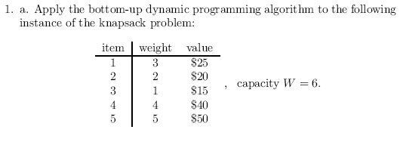
Exercise
How to find out which items are in the optimal subset?

Slide 39
Comments
This algorithm only finds the max possible value that can be carried in the knapsack
i.e., the value in V[n,W]
To know the items that make this maximum value, an addition to this algorithm is necessary

Slide 40
How to find actual Knapsack Items
All of the information we need is in the table.
V[n,W] is the maximal value of items that can be placed in the Knapsack.
Let i=n and k=W
if V[i,k] ≠ V[i−1,k] then
mark the i^{th} item as in the knapsack
i = i−1, k = k-w_{i}
else
i = i−1 // Assume the i^{th} item is not in the knapsack
// Could it be in the optimally packed knapsack?

Slide 41
Finding the Items
Items:
1: (2,3)
2: (3,4)
3: (4,5)
4: (5,6)
i\W
0
1
2
3
4
5
i=4
k= 5
b_{i}=6
w_{i}=5
V[i,k] = 7
V[i−1,k] =7
0
0
0
0
0
0
0
1
0
0
3
3
3
3
2
0
0
3
4
4
7
3
0
0
3
4
5
7
4
0
0
3
4
5
7
i=n, k=W
while i,k > 0
if V[i,k] ≠ V[i−1,k] then
mark the i^{th} item as in the knapsack
i = i−1, k = k-w_{i}
else
i = i−1

Slide 42
Finding the Items (2)
Items:
1: (2,3)
2: (3,4)
3: (4,5)
4: (5,6)
i\W
0
1
2
3
4
5
i=4
k= 5
b_{i}=6
w_{i}=5
V[i,k] = 7
V[i−1,k] =7
0
0
0
0
0
0
0
1
0
0
3
3
3
3
2
0
0
3
4
4
7
3
0
0
3
4
5
7
4
0
0
3
4
5
7
i=n, k=W
while i,k > 0
if V[i,k] ≠ V[i−1,k] then
mark the i^{th} item as in the knapsack
i = i−1, k = k-w_{i}
else
i = i−1

Slide 43
Finding the Items (3)
Items:
1: (2,3)
2: (3,4)
3: (4,5)
4: (5,6)
i\W
0
1
2
3
4
5
i=3
k= 5
b_{i}=5
w_{i}=4
V[i,k] = 7
V[i−1,k] =7
0
0
0
0
0
0
0
1
0
0
3
3
3
3
2
0
0
3
4
4
7
3
0
0
3
4
5
7
4
0
0
3
4
5
7
i=n, k=W
while i,k > 0
if V[i,k] ≠ V[i−1,k] then
mark the i^{th} item as in the knapsack
i = i−1, k = k-w_{i}
else
i = i−1

Slide 44
Finding the Items (4)
Items:
1: (2,3)
2: (3,4)
3: (4,5)
4: (5,6)
i\W
0
1
2
3
4
5
i=2
k= 5
b_{i}=4
w_{i}=3
V[i,k] = 7
V[i−1,k] =3
k − w_{i}=2
0
0
0
0
0
0
0
1
0
0
3
3
3
3
2
0
0
3
4
4
7
7
3
0
0
3
4
5
7
4
0
0
3
4
5
7
i=n, k=W
while i,k > 0
if V[i,k] ≠ V[i−1,k] then
mark the i^{th} item as in the knapsack
i = i−1, k = k-w_{i}
else
i = i−1

Slide 45
Finding the Items (5)
Items:
1: (2,3)
2: (3,4)
3: (4,5)
4: (5,6)
i\W
0
1
2
3
4
5
i=1
k= 2
b_{i}=3
w_{i}=2
V[i,k] = 3
V[i−1,k] =0
k − w_{i}=0
0
0
0
0
0
0
0
1
0
0
3
3
3
3
3
2
0
0
3
4
4
7
3
0
0
3
4
5
7
4
0
0
3
4
5
7
i=n, k=W
while i,k > 0
if V[i,k] ≠ V[i−1,k] then
mark the i^{th} item as in the knapsack
i = i−1, k = k-w_{i}
else
i = i−1

Slide 46
Finding the Items (6)
Items:
1: (2,3)
2: (3,4)
3: (4,5)
4: (5,6)
i\W
0
1
2
3
4
5
i=0
k= 0
0
0
0
0
0
0
0
1
0
0
3
3
3
3
2
0
0
3
4
4
7
3
0
0
3
4
5
7
The optimal knapsack should contain {1, 2}
4
0
0
3
4
5
7
i=n, k=W
while i,k > 0
if V[i,k] ≠ V[i−1,k] then
mark the n^{th} item as in the knapsack
i = i−1, k = k-w_{i}
else
i = i−1

Slide 47
Finding the Items (7)
Items:
1: (2,3)
2: (3,4)
3: (4,5)
4: (5,6)
i\W
0
1
2
3
4
5
0
0
0
0
0
0
0
1
0
0
3
3
3
3
3
2
0
0
3
4
4
7
7
3
0
0
3
4
5
7
The optimal knapsack should contain {1, 2}
4
0
0
3
4
5
7
i=n, k=W
while i,k > 0
if V[i,k] ≠ V[i−1,k] then
mark the n^{th} item as in the knapsack
i = i−1, k = k-w_{i}
else
i = i−1

Slide 48
Memorization (Memory Function Method)
Goal:
Solve only subproblems that are necessary and solve it only once
Memorization is another way to deal with overlapping subproblems in dynamic programming
With memorization, we implement the algorithm recursively:
If we encounter a new subproblem, we compute and store the solution.
If we encounter a subproblem we have seen, we look up the answer
Most useful when the algorithm is easiest to implement recursively
Especially if we do not need solutions to all subproblems.

Slide 49
0-1 Knapsack Memory Function Algorithm
for i = 1 to n
for w = 1 to W
V[i,w] = -1
for w = 0 to W
V[0,w] = 0
for i = 1 to n
V[i,0] = 0
MFKnapsack(i, w)
if V[i,w] < 0
if w < w_{i}
value = MFKnapsack(i-1, w)
else
value = max(MFKnapsack(i-1, w),
b_{i} + MFKnapsack(i-1, w-w_{i}))
V[i,w] = value
return V[i,w]

Slide 50
Conclusion
Dynamic programming is a useful technique of solving certain kind of problems
When the solution can be recursively described in terms of partial solutions, we can store these partial solutions and re-use them as necessary (memorization)
Running time of dynamic programming algorithm vs. naïve algorithm:
0-1 Knapsack problem: O(W*n) vs. O(2^{n})

Slide 51
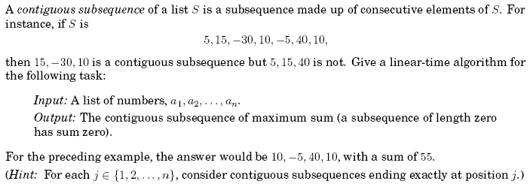
In-Class Exercise

Slide 52
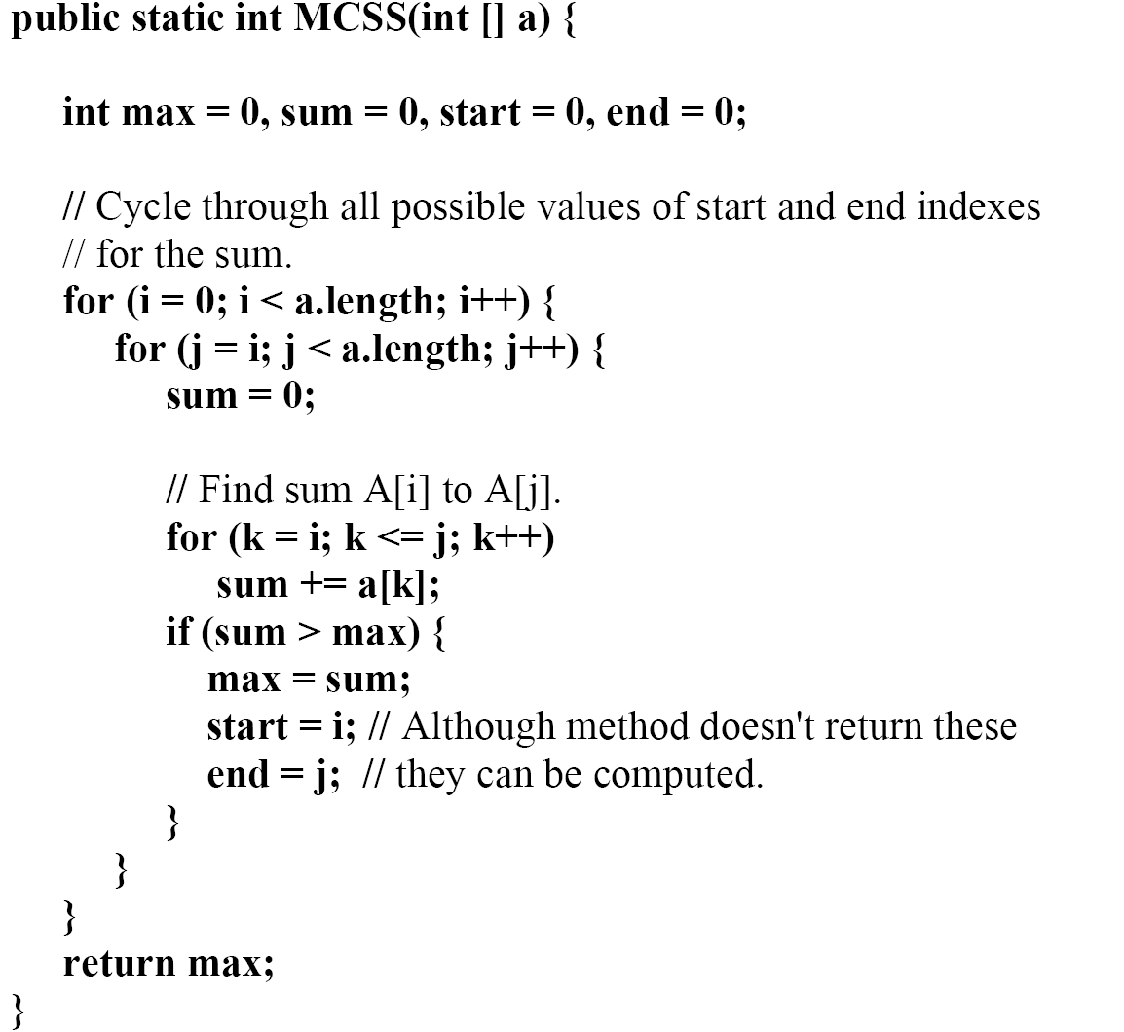
Brute-Force Approach

Slide 53
Dynamic-Programming Approach
(1) SMaxV(0) = 0
(2) MaxV(0) = 0
(3) for i=1 to n
(4) SMaxV(i) = max(SmaxV(i-1)+x_{i}, 0)
(5) MaxV(i) = max(MaxV(i-1), SMaxV(i))
(6) return MaxV(n)
Run the algorithm on the following example instance:
30, 40, -100, 10, 20, 50, -60, 90, -180, 100

